Slide 1
Class 2: Language and Literature
Dance, Drama and Drums: How humans developed culture

Slide 2
Welcome back!
Let’s take a look at your questions.

Slide 3
Behaviour doesn’t fossilise!

Slide 4
Is the use of language unique to humans?
Notes:
I want to start with a crucial question. Do you think the use of language is unique to humans? Other animals do communicate with one another, but is language itself unique? What does language actually mean? (There are over 6000 distinct languages

Slide 5
Introducing the KE family
1998 at Great Ormond Street Hospital
Child had a speech disorder - it involved trouble in turning specific sounds into syllables. (Imagine saying ‘bu’ instead of saying ‘blue.’)
The cause? FOXP2
Rutherford, A. The Book of Humans, 2018.

Slide 6
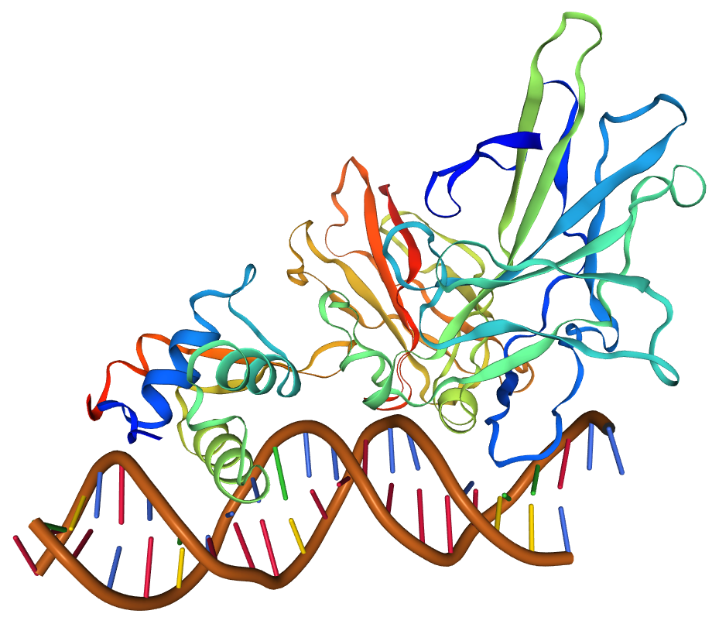
FOXP2
Forkhead box protein 2
Initially dubbed ‘the language gene’
Mutations in the gene cause severe verbal dyspraxia (the KE family!)
It’s not the only gene responsible for causing language in humans...
...but studies in mice have shown it’s really important to the development of it nonetheless.
By SWISS-MODEL - https://swissmodel.expasy.org/repository/uniprot/P23258?template=6v5v, CC BY-SA 4.0, https://commons.wikimedia.org/w/index.php?curid=86391787

Slide 7
Why is FOXP2 important?
This gene is seen in more than just animals - birds, fish, even alligators.
The difference? Two amino acids.
Adam Rutherford notes that these two amino acids seem to distinguish the human ability to produce language from the non-human non-ability.
Bats’ FOXP2 plays a role in echolocation and can affect the way songbirds sing if mutations in FOXP2 occur.
Notes:
Threonine to asparagine substitution at position 303, asparagine to serine at position 305.

Slide 8
The bare bones of it all...
The hyoid bone is VERY important as we move forward.
Sits alongside the tongue, larynx and pharynx. Helps create a variety of movements
Present in Neanderthals - but we can’t say if it made speech work.

Slide 9
So could Neanderthals speak?
According to Adam Rutherford, ‘very probably.’
Kebara Cave, Israel ->
Svante Päabo
Notes:
Adam Rutherford notes in his amazing book, ‘A Brief History of Everyone Who Ever Lived,’ that the question of whether Neanderthals could speak is a really popular question for anyone just starting out in paleoanthropology and we’re not entirely sure of the answer. However, there are two pieces of evidence that might suggest that the answer is yes.
The first is the dig at the Kebara Cave in 1989. The dig revealed the most complete Neanderthal skeleton to date and the first Neanderthal hyoid bone, as we just discussed.
The second we have Svante Päabo at the Max Planck Institute for the Science of Human History to thank for. The sequencing of the Neanderthal genome, which is now possible thanks to advances in genetic technology, shows that the FOXP2 gene that Neanderthals had was essentially the same as the FOXP2 gene that we have. We know it’s essential for speech, we’re just not sure how!

Slide 10
Ok, so what?
Notes:
Now at this point you might be thinking, ‘OK perfect, Neanderthals could speak. But what were they actually saying to each other? Were they actually saying anything or was it noises?’ And there we find the distinction between language and literature.

Slide 11
There are many examples of prehistoric languages...
Now keep in mind - prehistory means ‘before written record!’
Rules of language evolution suggest that the first language would have emerged over 120,000-150,000 years ago (after the Out of Africa movement), but we have no idea what this root language is!
So instead, let me introduce you to a few other pre-historic languages, the evidence we have for them and some of the literature we have from them (if that’s a thing!)

Slide 12
Sidenote!
Linguistics fans may know of the Sapir-Whorf Hypothesis that suggested (in summary) that languages tend to only have words to describe what their users actually need.
That hypothesis has been widely discredited, but think about the world today: ‘googeln’ is now a verb in German, but has it always been?
Languages tend to work for specific purposes

Slide 13
Linear A
Used by the Minoans, an ancient civilisation that lived on the island of Crete!
Really only used for palace records and economic records.
Never been deciphered and we don’t know its origins!

Slide 14
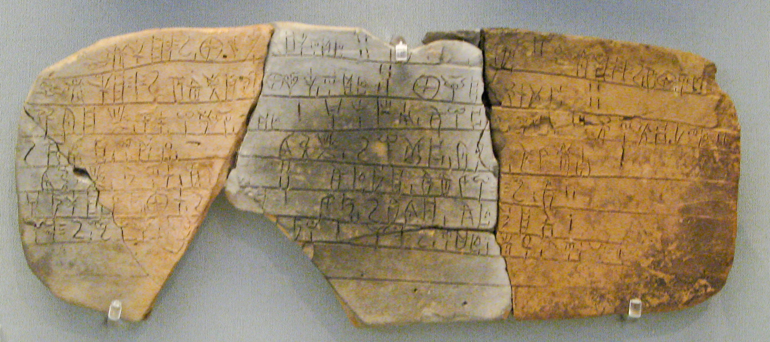
Linear B
Linear A was a precursor to it!
Used by the Mycenaeans, a precursor to Ancient Greek.
By Sharon Mollerus - originally posted to Flickr as How Cool Is Writing?, CC BY 2.0, https://commons.wikimedia.org/w/index.php?curid=7633385
Notes:
The clay tablet you’re looking at here is fairly standard for Linear B. This is the only Bronze Age Aegean script to have been deciphered, but its use disappeared after the fall of the Mycenaeans and the beginning of the Dark Ages. (if you’re interested, look into the Sea People’s!)

Slide 15
Cuneiform
Used to write 10+ languages, including Akkadian and Sumerian. In use from the early Bronze Age through to Common Era.
Notes:
These tablets are dated to around 3500 BCE and show quite possibly the earliest example of writing. These tablets are at the Ashmolean Museum in Oxford.

Slide 16
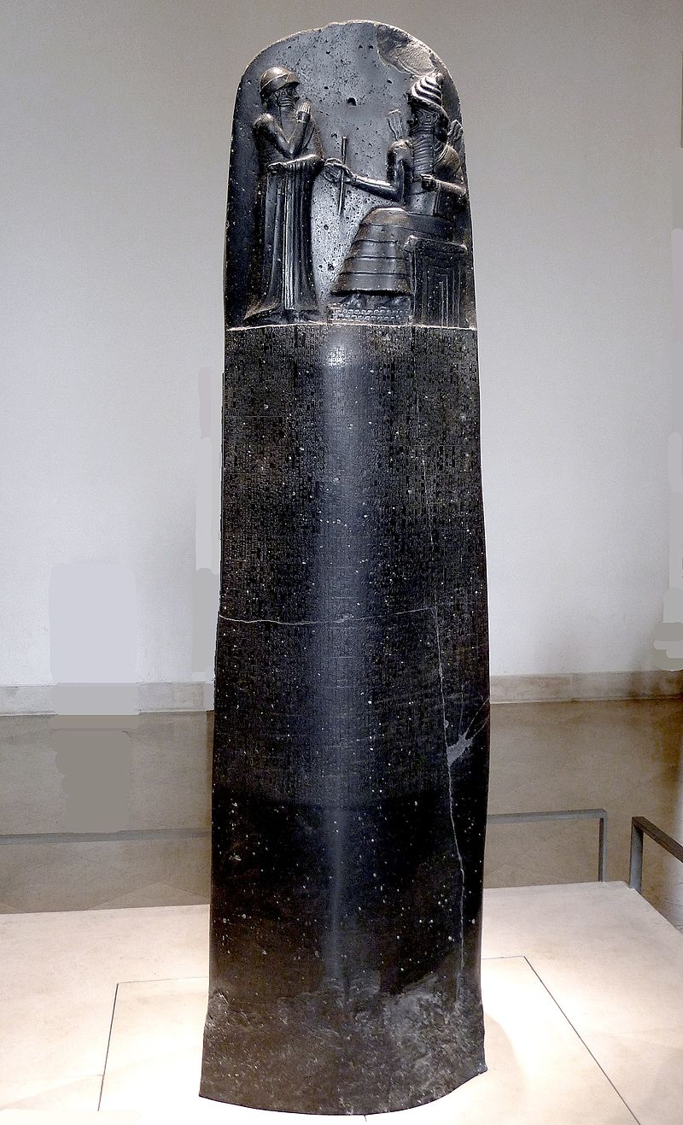
The Code of Hammurabi
By Mbzt - Own work, CC BY 3.0, https://commons.wikimedia.org/w/index.php?curid=16931676
Notes:
This stele is written in Akkadian, which used the Cuneiform script, and is an example of one of the earliest law codes. This stele is the original and it’s in the Louvre in Paris. The law code is particularly interesting since it covers a really broad scope. All of the laws are written in the conditional, so ‘if this then that.’ The laws include provisions for if an adopted child says to their mother or father that they aren’t the child’s real parents then their tongue shall be cut off. There is also a law that says that if a builder completes bad work and the son of the customer dies as a result of the poor work then the son of the builder shall also be put to death. It’s quite gory, but remains one of the earliest law codes and replicas are in lots of places, including the US Capitol.

Slide 17
The Epic of Gilgamesh
Tablet 11 - ‘Story of the Flood’ (sound familiar?)
Notes:
This is particularly important. The Epic of Gilgamesh is written in Akkadian (using the Cuneiform script), and the tablet above is Tablet 11 telling the story of the Flood. The Epic is significant, in my opinion, for two reasons. The first is that some of the best tablets telling the story were discovered at the ruins of the Library of Ashurbanipal, who ruled in the 7th Century BCE. Think about how significant that is for a king then to have had libraries! The second is that the Epic of Gilgamesh is considered to be the earliest example of great literature - at least, that has survived and that we know of.

Slide 18
Hieroglyphs
The Pyramid Texts as inscribed in Teti’s pyramid.
Notes:
Of course, even older than that are the Pyramid Texts written in Egyptian hieroglyphs! Everybody had an Egyptology phase at one point, right? These are the oldest religious texts, the Epic of Gilgamesh that we just saw being the second oldest. The Pyramid Texts are generally dated to around 2350 BCE, but use of hieroglyphs date back to about 3400 BCE. Pretty old right?

Slide 19
Chinese characters
Perhaps 8600 years old?
Notes:
Chinese characters might be the oldest system of writing, if recent Neolithic finds are anything to go by. The first picture on the right are tortoise shells, dated to around 8600 years old, inscribed with signs that archaeologists have suggested might be the first system of writing. Keep in mind, the first system of writing was in Mesopotamia around 2000 years later. However, whether or not these tortoise shells actually constitute Chinese is HEAVILY disputed by Chinese scholars. The first known use of Chinese characters was in the Shang dynasty, and these characters have come to be known as the Oracle Bone Inscriptions since they were inscribed onto tortoise shells or shells of other mammals. I wish we had more time to look into the development of Chinese characters because it is fascinating and I highly encourage you to look into it - I’ll include some further reading in an email after class in case you want to take a look! https://www.brown.edu/about/administration/international-affairs/year-of-china/language-and-cultural-resources/introduction-chinese-characters/introduction-chinese-characters

Slide 20
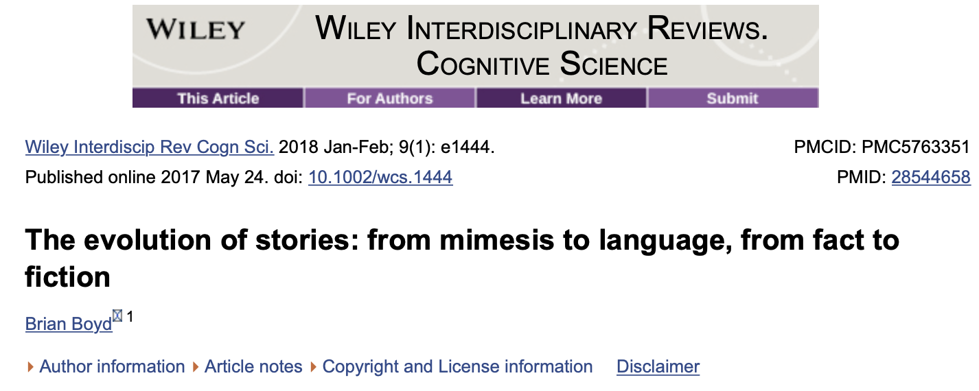
Why would humans bother with stories at all?
Notes:
Brian Boyd wrote this fascinating paper which, again, I’ll send a link to if you’re interested in reading more. On the face of it, he says, you’d think that storytelling is a bit of a waste of evolutionary time and energy. We can prove that we are not the only species that evolved to have the capabilities to tell stories, but common relatives of ours like chimpanzees can’t communicate beyond the here and now. We, however, have the ability to talk and pool our knowledge to further us all. Boyd essentially writes that stories formed a really effective way to pool more knowledge faster than before. You can think about this in terms of your own lives too. Why are mnemonics so effective for so many? Can you still remember some of the simple stories you were told as children and the morals of those stories? (Ask for examples!)

Slide 21
That’s all for this week!
bit.ly/culture-class-questions
Notes:
Next week, we’ll look at something else that might at first glance seem counterintuitive to our understanding of evolution - art. Before then, I’d be grateful if you could, once again, answer the questions survey which is at the same link as last week!

